Slide 1
SNTP (Simple Network Time Protocol)

Slide 2
Clock Synchronization
Clock synchronization is a topic in computer networks that aims to coordinate independent clocks.
Even when initially set accurately, real clocks will differ after some amount of time due to clock drift, caused by clocks counting time at slightly different rates.
Synchronization is required for accurate reproduction of streaming media.
Clock synchronization is a significant component of audio over Ethernet systems.

Slide 3
Clock Synchronization
In a central server system, the synchronization solution is trivial; the server will dictate the system time.
Cristian's algorithm and the Berkeley algorithm are potential solutions to the clock synchronization problem in central environment.
In distributed computing, the problem takes on more complexity because a global time is not easily known.
The most used clock synchronization solution on the Internet is the Network Time Protocol (NTP) which is a layered client-server architecture based on User Datagram Protocol (UDP) message passing.

Slide 4
NTP / SNTP
Simple Network Time Protocol (SNTP) is a simplified version of Network Time Protocol (NTP) that is used to synchronize computer clocks on a network.
This simplified version of NTP is generally used when full implementation of NTP is not needed.
(NTP) is a highly robust protocol, widely deployed throughout the Internet.
Well tested over the years, it is generally regarded as the state of the art in distributed time synchronization protocols for unreliable networks.

Slide 5
NTP / SNTP
It can reduce synchronization offsets to times of the order of a few milliseconds over the public Internet, and to sub-millisecond levels over local area networks.
A simplified version of the NTP protocol, Simple Network Time Protocol (SNTP), can also be used as a pure single-shot stateless primary/secondary synchronization protocol, but lacks the sophisticated features of NTP, and thus has much lower performance and reliability levels.

Slide 6
NTP / SNTP
SNTP supports unicast, multicast and anycast operating modes.
In unicast mode, the client sends a request to a dedicated server by referencing its unicast address.
Once a reply is received from the server, the client determines the time, roundtrip delay and local clock offset in reference to the server.
In multicast mode, the server sends an unsolicited message to a dedicated IPv4 or IPv6 local broadcast address.

Slide 7
NTP / SNTP
Generally, a multicast client does not send any requests to the service because of the service disruption caused by unknown and untrusted multicast servers.
The disruption can be avoided through an access control mechanism that allows a client to select a designated server he or she knows and trusts.

Slide 8
NTP / SNTP
In both the NTP and SNTP protocols the communication begins with a request message by the client.
Furthermore, they send and receive the same message format with the server.
The main difference between both is the synchronization process that they carry out.
The NTP protocol can use various servers and takes into account the tripping speed of the component that requests the time.
As it uses several devices, the NTP method can distinguish the time of those that move away from the others.
This gives the NTP protocol more reliability than SNTP, which only uses one server or master clock.

Slide 9
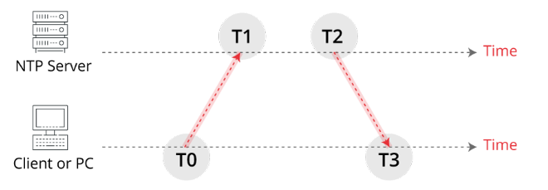
Exchange of messages in NTP protocol

Slide 10

NTP functioning
A synchronization request is sent at the T0 instant on the client’s side that checks if the time lag between the server and the requester is greater than 17 minutes.
The message arrives to the server in the T1 instant:
If the time delay is greater than 17 minutes, the process will not continue, and will end without synchronization.
However, if the time is less than 17 minutes, the synchronization continues. The server sends a message with its time in the instant T2.
The packet is received in the client in the instant T3. A gradual time adjustment is made every minute until it approaches 128 ms of server time. The delay (θ) between both clocks is calculated as:

Slide 11
SNTP
The SNTP method is much simpler than the NTP, given that it bypasses various steps and only periodically adjusts the time, obtaining less accuracy.
The latest version of this protocol is SNTPv4. The main problem of this protocol is its low security.
As it lacks an encryption method, it is vulnerable to attacks in which the time can be modified.
The use of the SNTP protocol is interesting in the following cases:
Simple devices, such as microcontrollers and small computers, with little memory.
Equipment in which the time synchronization is not decisive.
Control devices like PLC, remote units and embedded devices.

Slide 12
Network Programming Lab

Slide 13
Goals for the Lab
Printing the current time from the internet time server with the help of NTP (Network Time Protocol).
Write an SNTP (Simple network time protocol) client that prints the current time from the internet time server received with the SNTP protocol.

Slide 14
Libraries used
ntplib
time
socket

Slide 15
Network Time Protocol (NTP)
First we have to pip install it “pip install ntplib”
We create an instance of “NTPClient” and then we call the “request()” method on it by passing the NTP server address.

Slide 16
SNTP
Unlike the previous recipe, sometimes, you don't need to get the precise time from the NTP server. You can use a simpler version of NTP called simple network time protocol.
You may find the value of the Epoch time or convert to the Epoch time at “http://www.epochconverter.com/”.
The actual client creates a UDP socket (SOCK_DGRAM) to connect to the server following the UDP protocol.
The client then needs to send the SNTP protocol data ('\x1b' + 47 * '\0') in a packet.

Slide 17
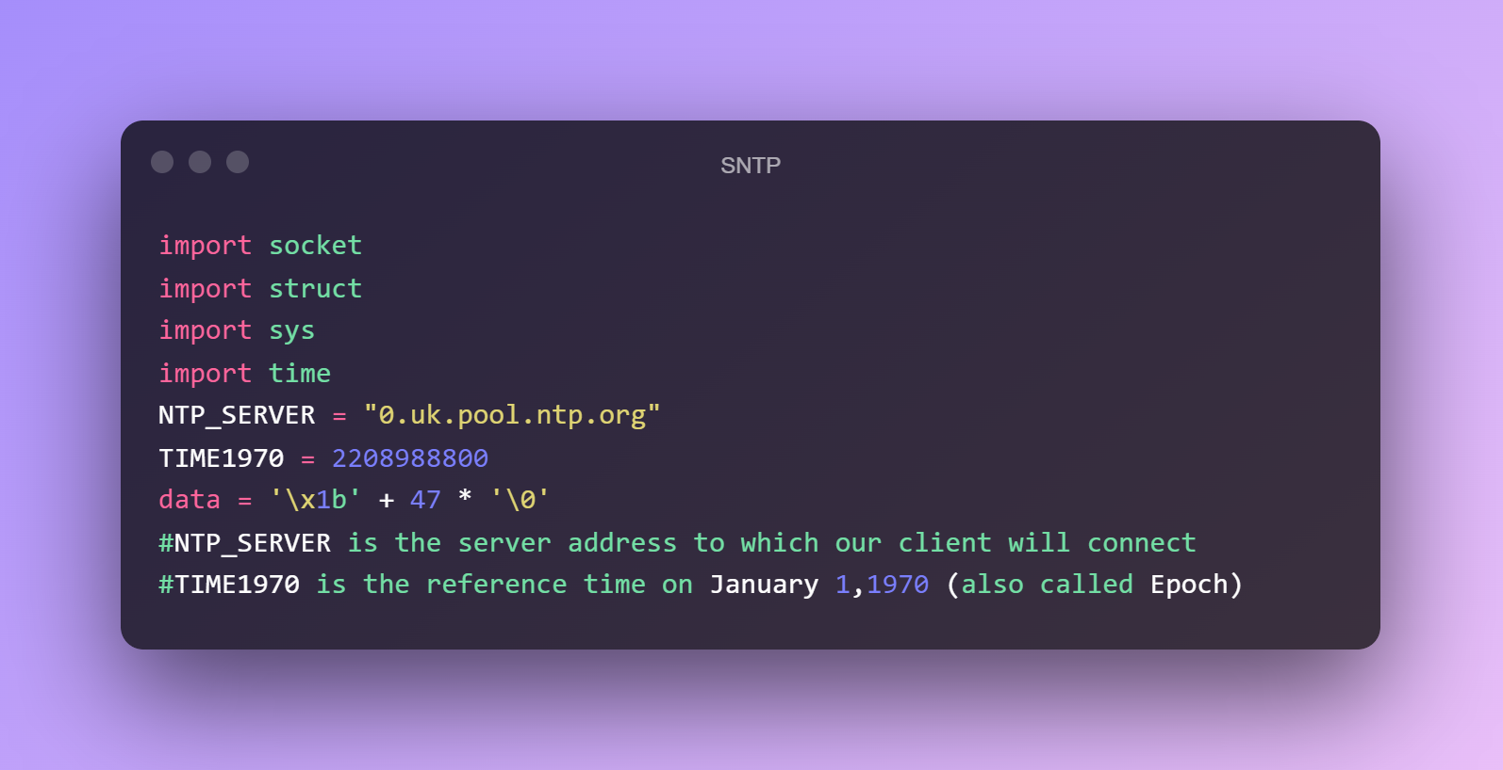
Contd.

Slide 18
The assignment
Printing the current time from the internet time server with the help of NTP? Also write an SNTP client that prints the current time from the internet time server received with the SNTP protocol?

Slide 19
References
https://stackoverflow.com/questions/26937857/what-does-the-x1b-47-0-message-sent-to-an-ntp-server-mean#:~:text=1%20Answer&text=%22%5Cx1b'%20%2B%2047%20*%20'%5C0%22%20represents%20a,of%20an%20NTP%20UDP%20packet.
http://www.epochconverter.com

